Slide 1
TA 111: Technical Arts
2023-24 II
Lecture 20
Auxiliary Views– II
Dr. Syam Nair
Department of Civil Engineering
IIT Kanpur
Office: FB 307
Phone: 6424
Email: syamnair@iitk.ac.in

Slide 2
Example 2
Given partial auxiliary views (containing true shapes of the faces), draw the front and top views of the object
10
φ20
40
10
10
20
20
60
40
40

Slide 3
Example 2
6
5
4
3
2
H
1
F
F
φ20
A1
20
3
2
4
1
5
6
40
F
A2

Slide 4
Example 2
φ20
20
40

Slide 5
Example 3
20
10
40
20
10
10
15
30
30
30
45
40
10
40
20
30
20
40
30
30
10
20
30
10

Slide 6
10
20
Example 3
40
20
10
10
15
30
30
30
45
40
10
40
20
40
30
20
30
30
10
20
30
10

Slide 7
Example 3

Slide 8
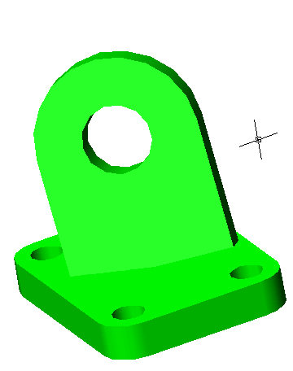
Example 4
AUXILIARY VIEW (A1)
A1
H
F
A1
A2
H
F
AUXILIARY VIEW (A2)

Slide 9
Thank You !!!

